Slide 1
Metamorphic Rocks

Slide 2
Metamorphism- literally means change of form
Dominant process throughout most of Earth’s lower part of upper crust, lower crust and mantle
A process involving changes in the mineral content /composition and/or microstructure of a rock, dominantly in the solid state. This process is mainly due to an adjustment of the rock to physical conditions that differ from those under which the rock originally formed and that also differ from the physical conditions normally occurring at the surface of the Earth and in the zone of diagenesis.

Slide 3
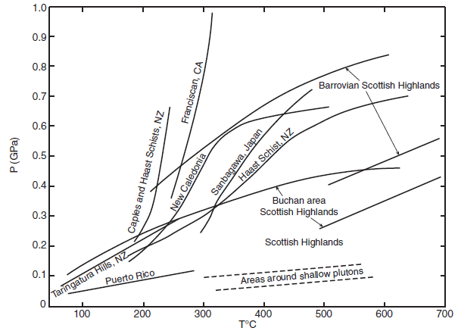
Agents of Metamorphism
Pressure
Temperature

Slide 4
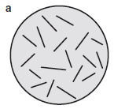
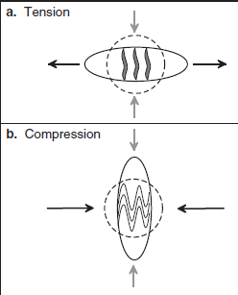
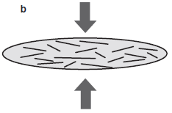
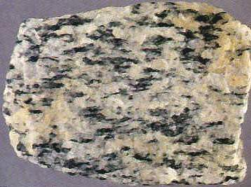
Deviatoric Stress

Slide 5
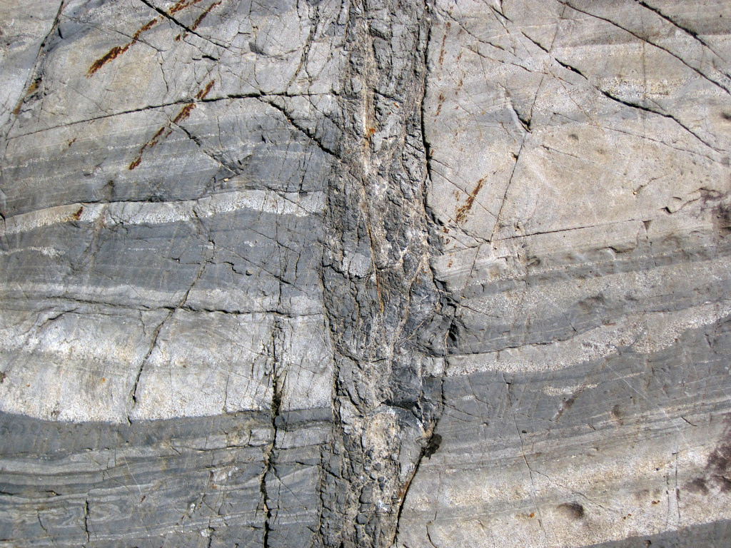

Slide 6
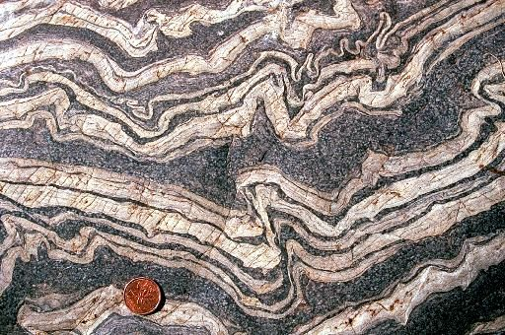

Slide 7
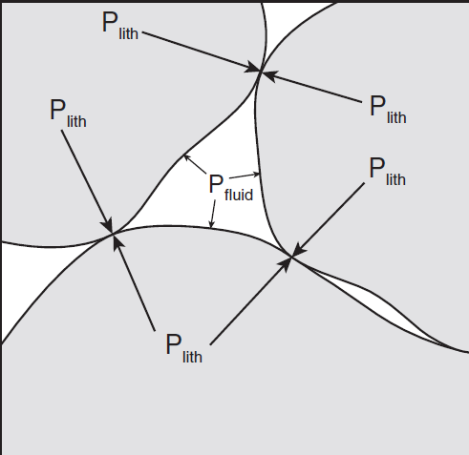

Slide 8
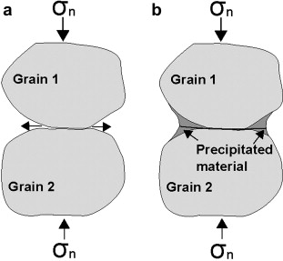
Pressure Solution

Slide 9
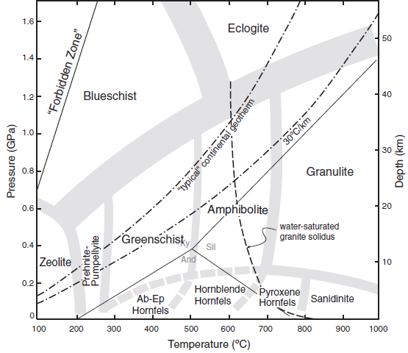
Metamorphic Facies

Slide 10
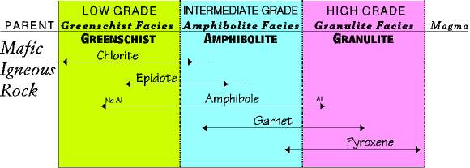
Barrovian Sequence- Mafic Rocks

Slide 11
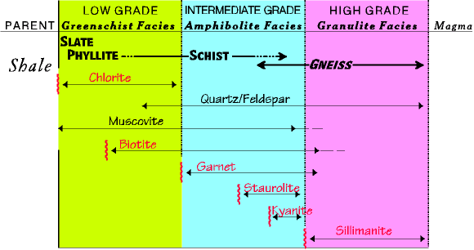
Barrovian Sequence- Pelitic Rocks

